Slide 1
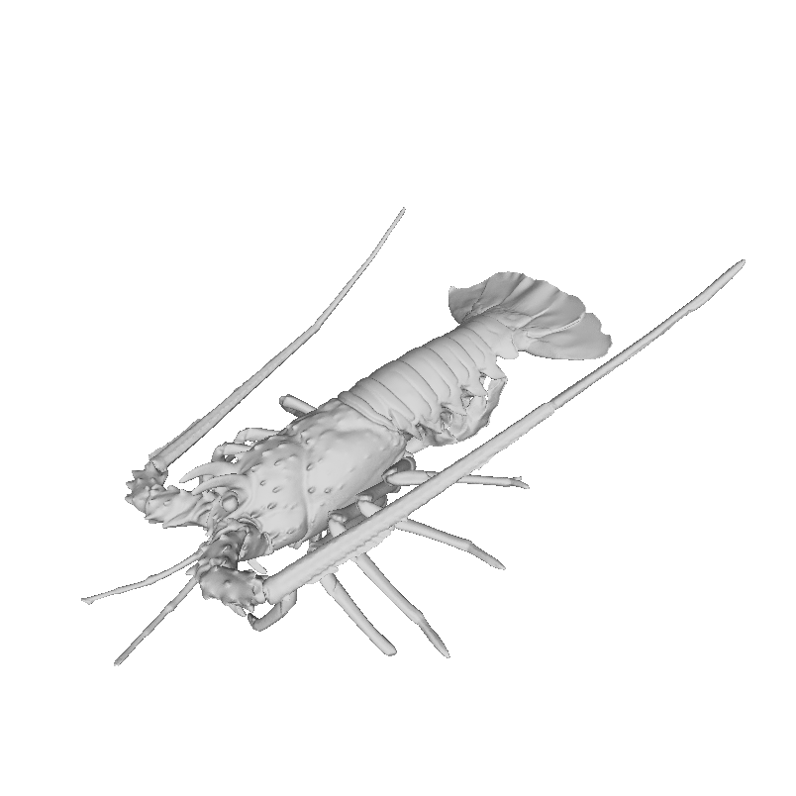
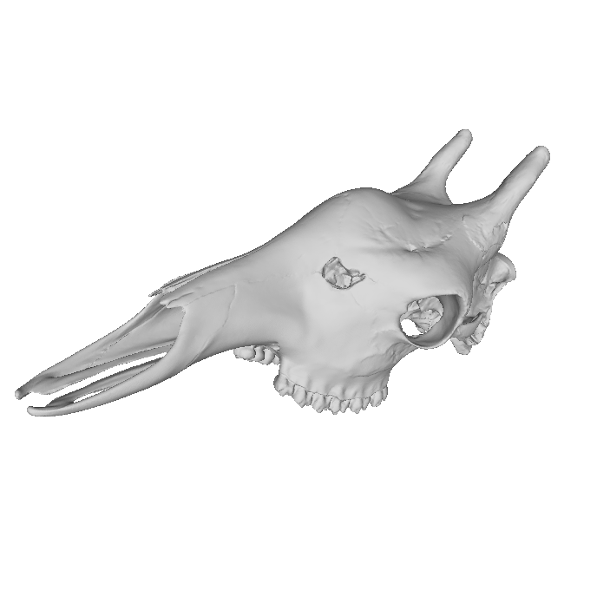
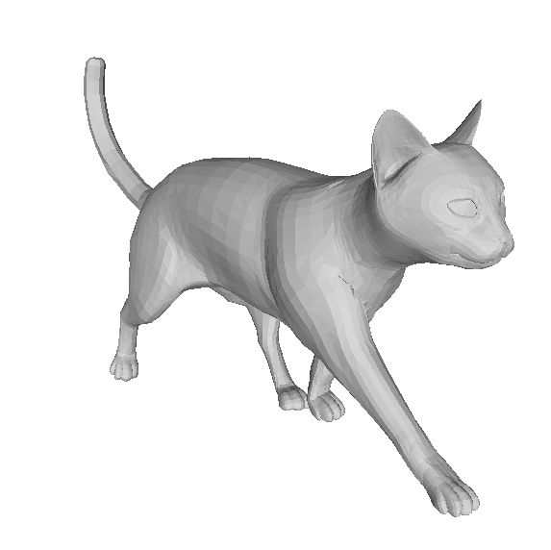
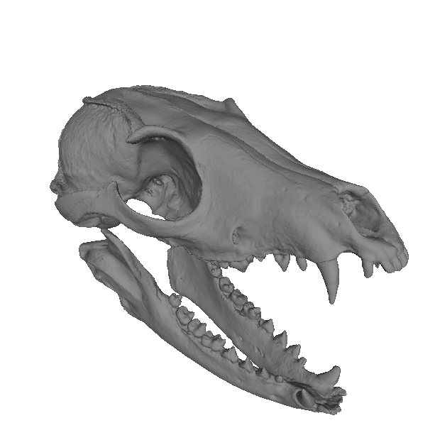
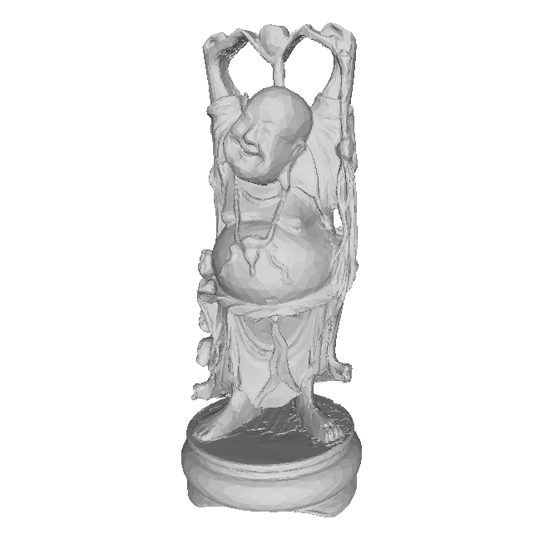
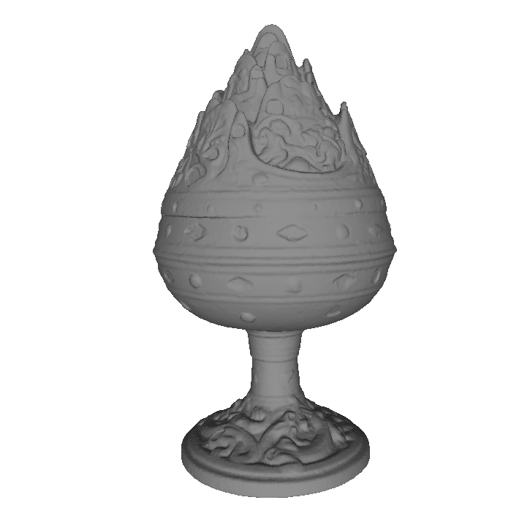
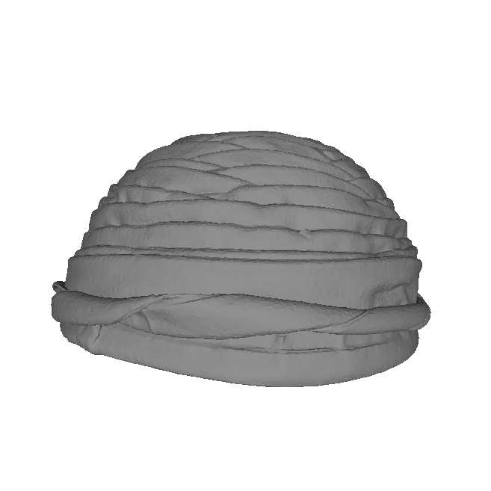
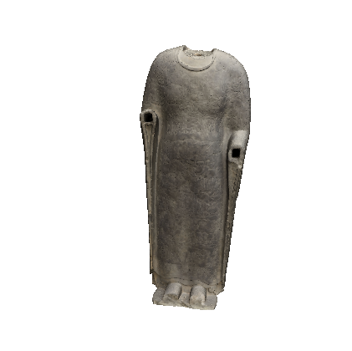
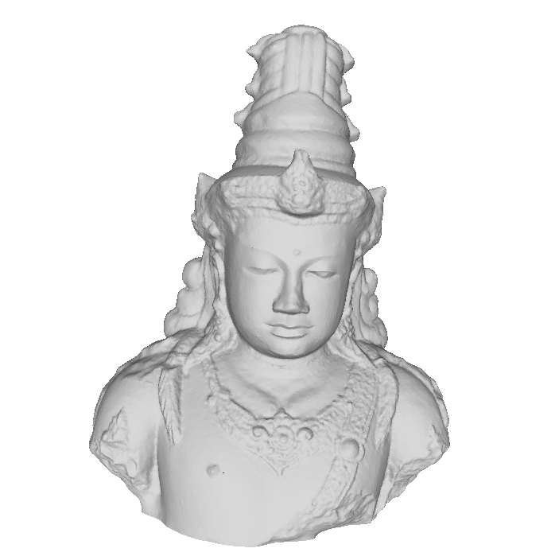
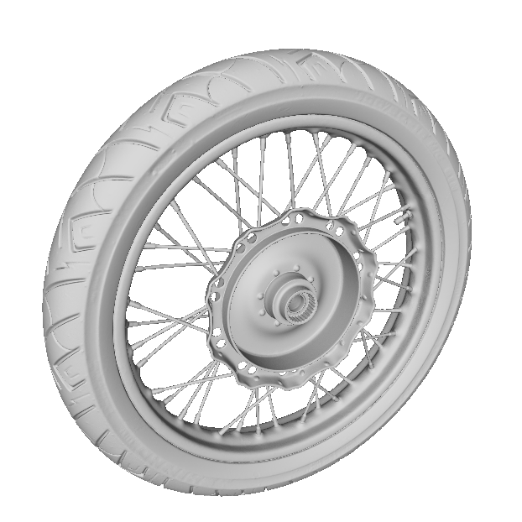
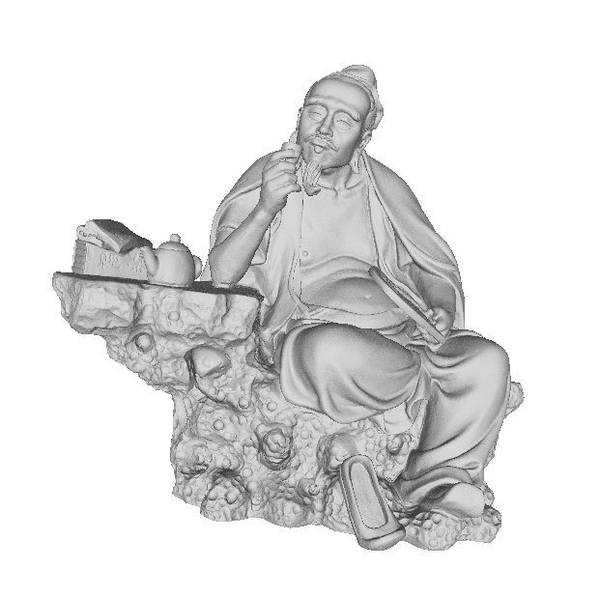
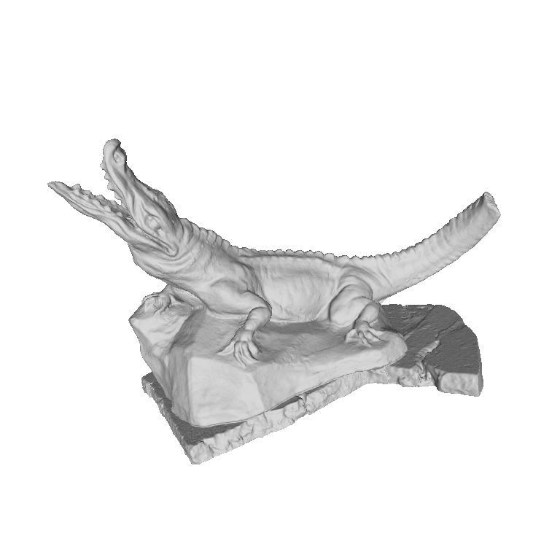
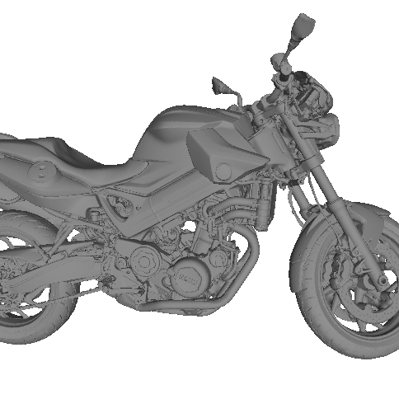
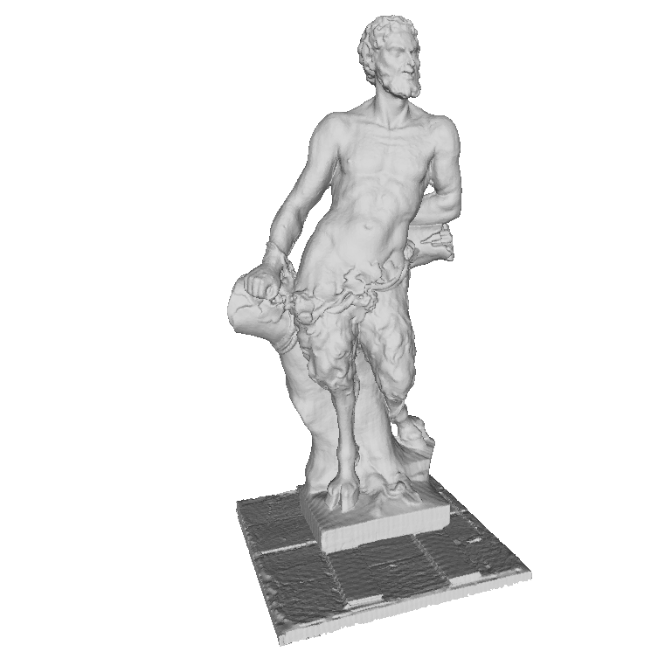
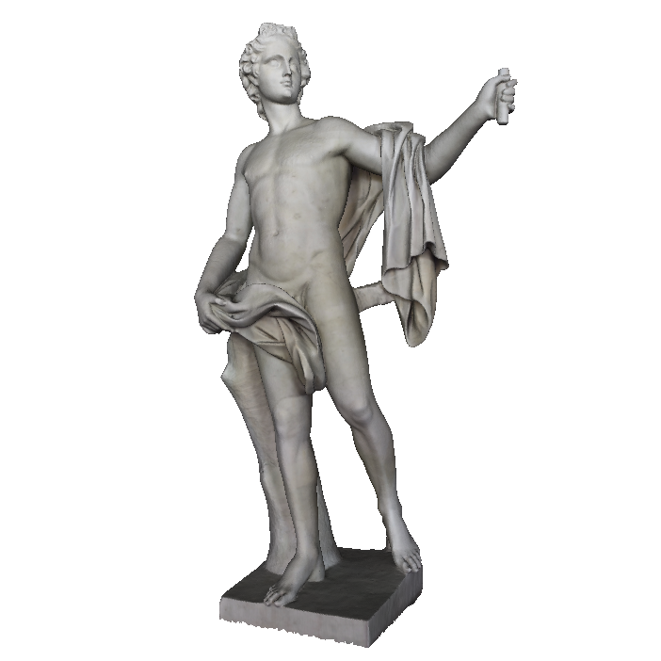
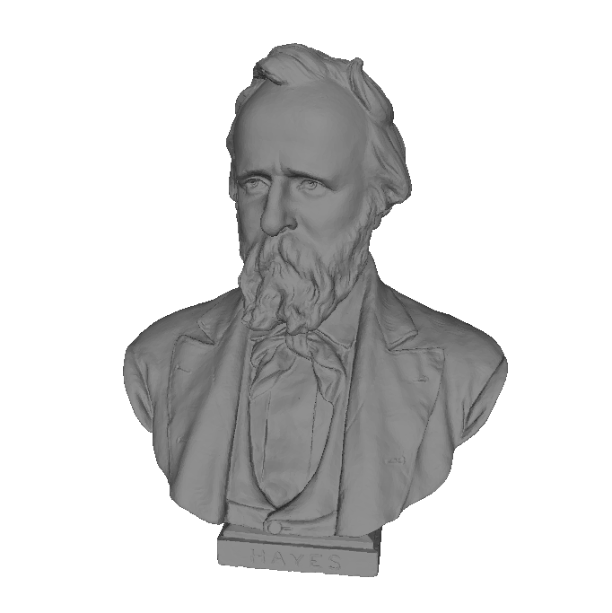
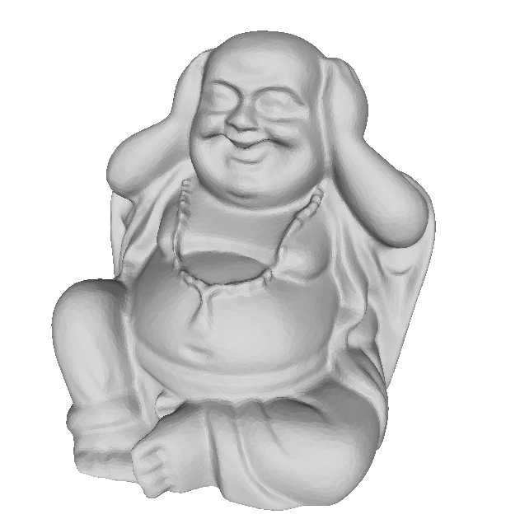
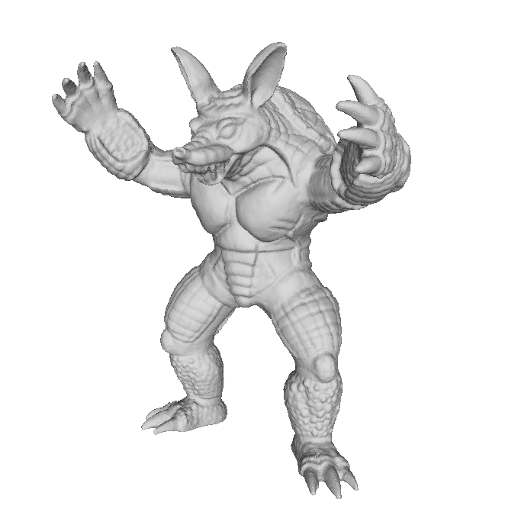
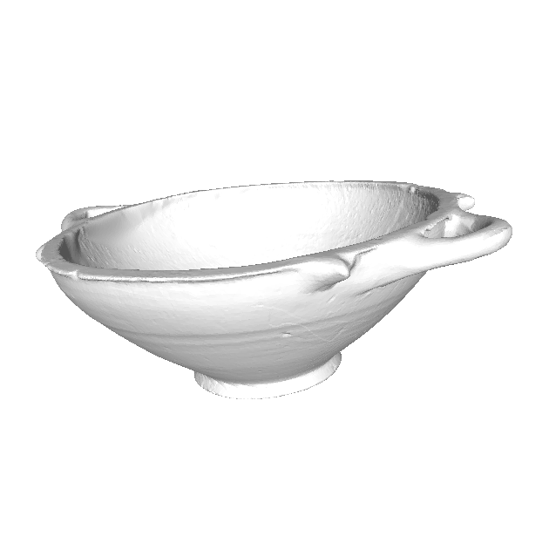
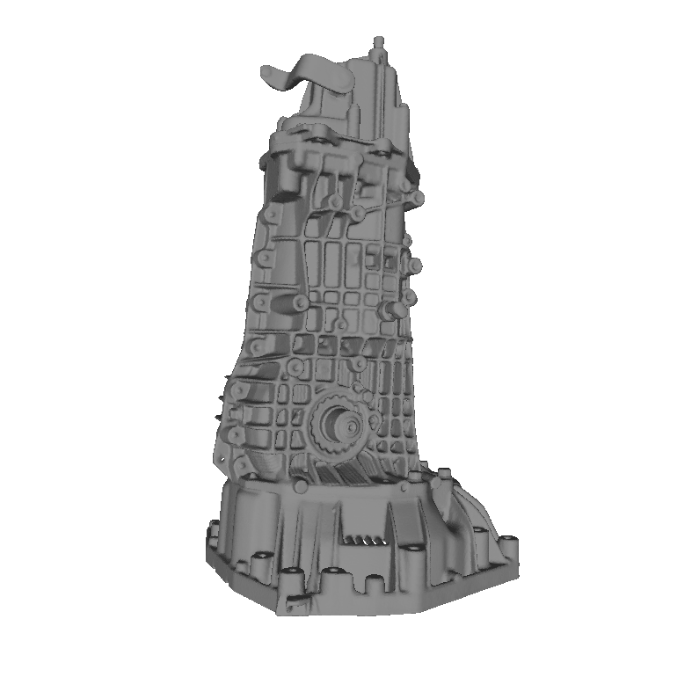
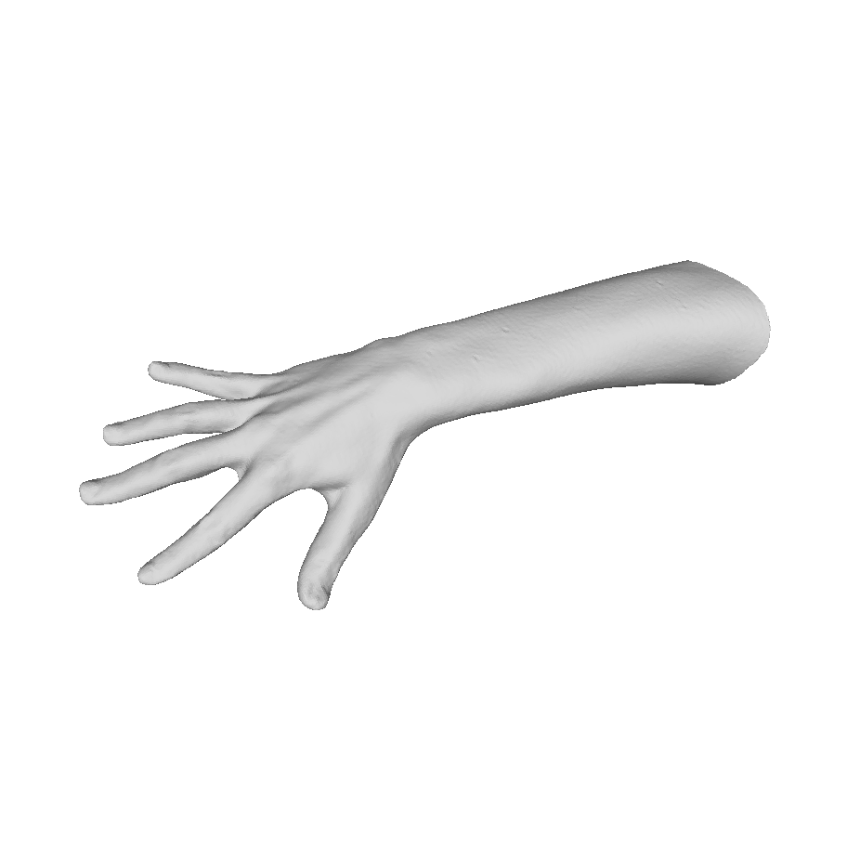
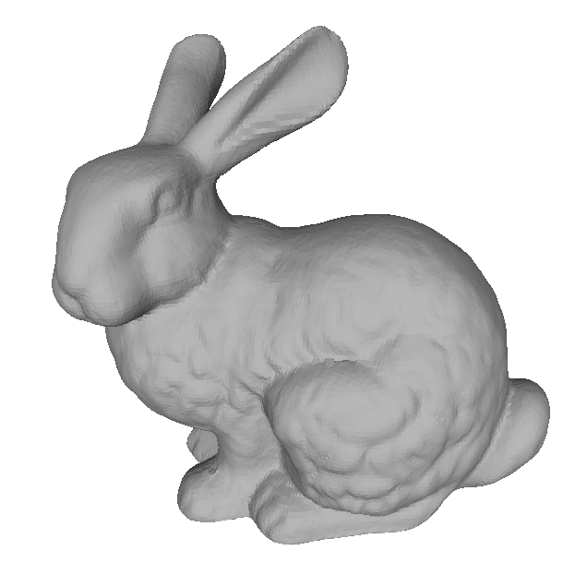
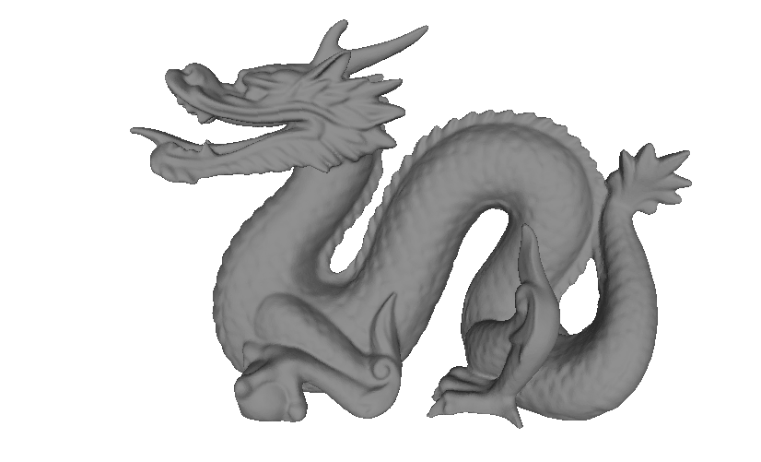
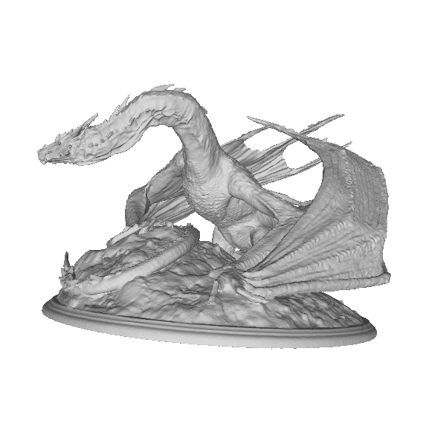
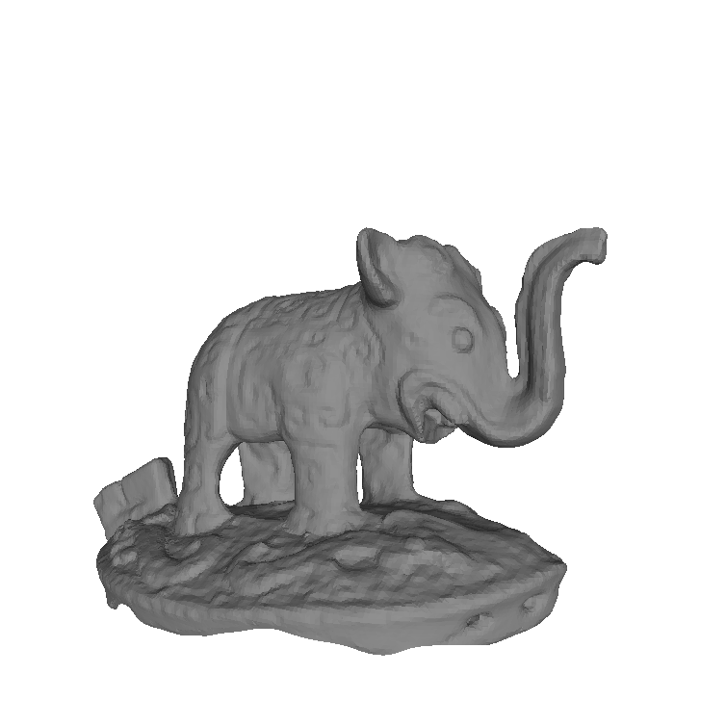
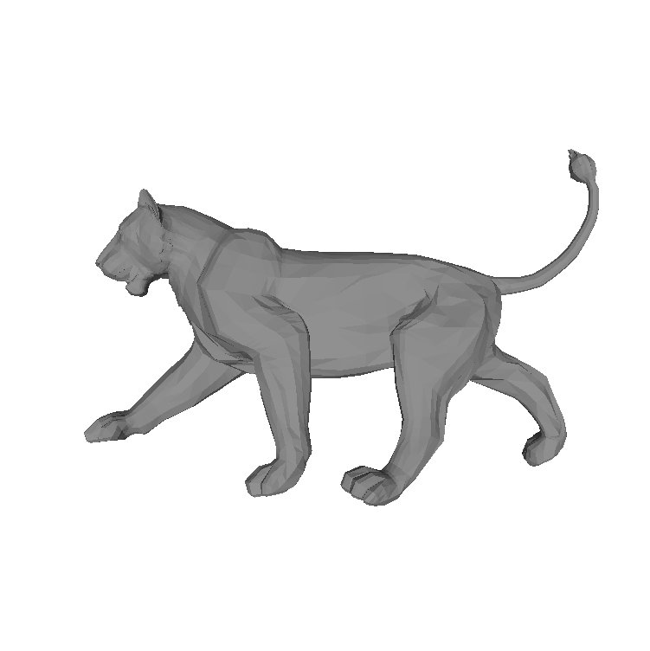
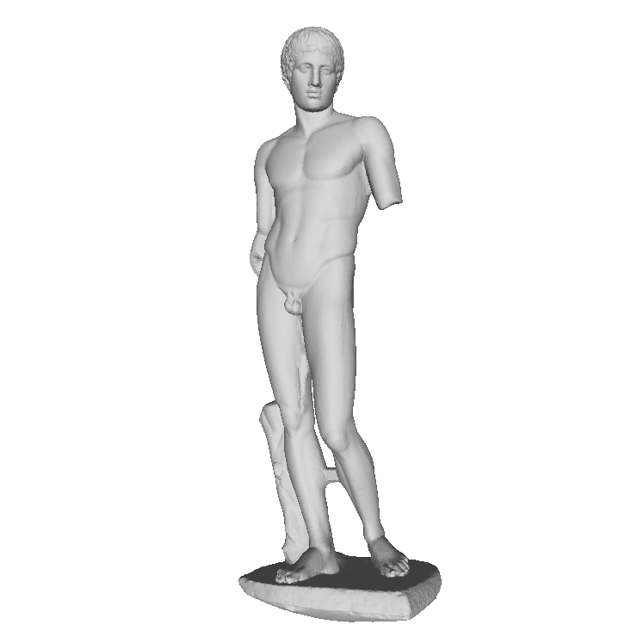
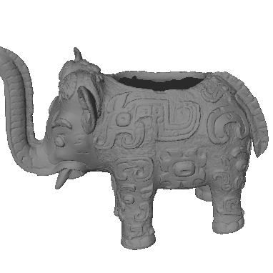
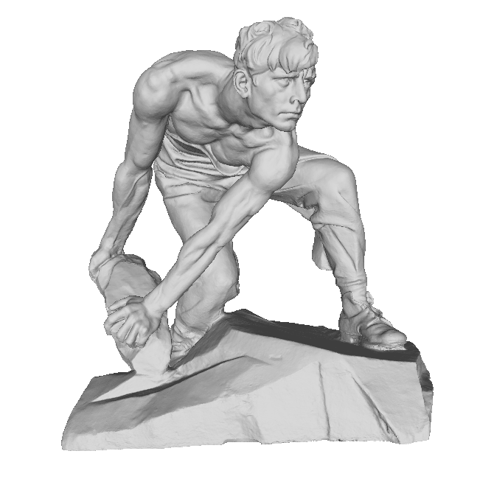
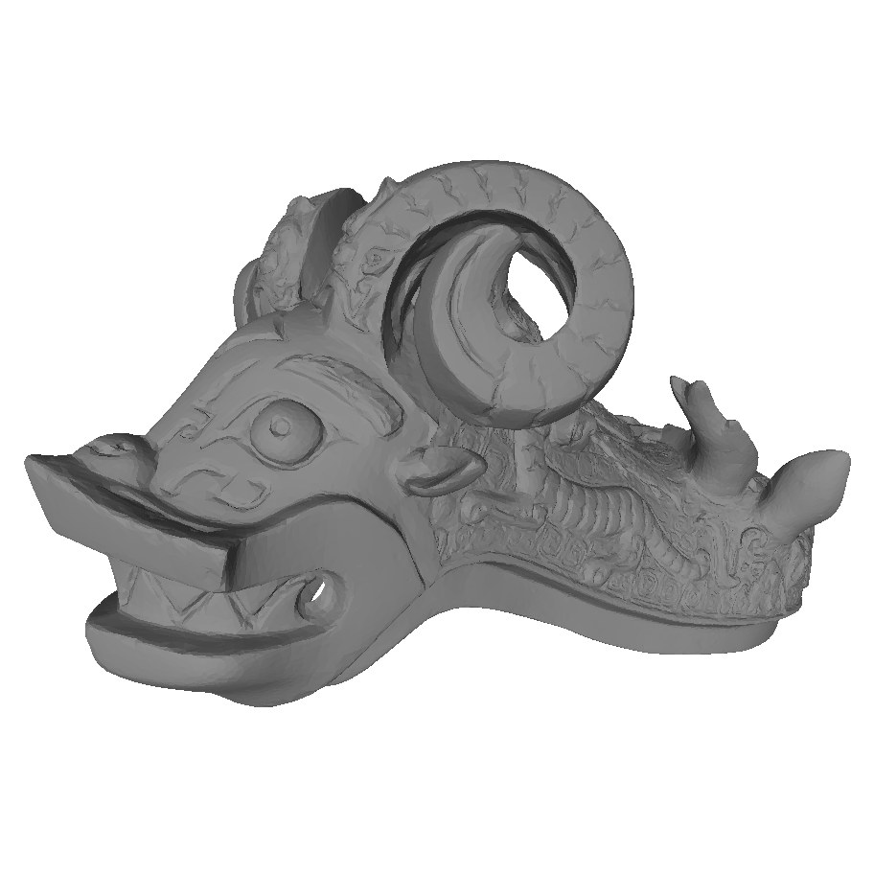
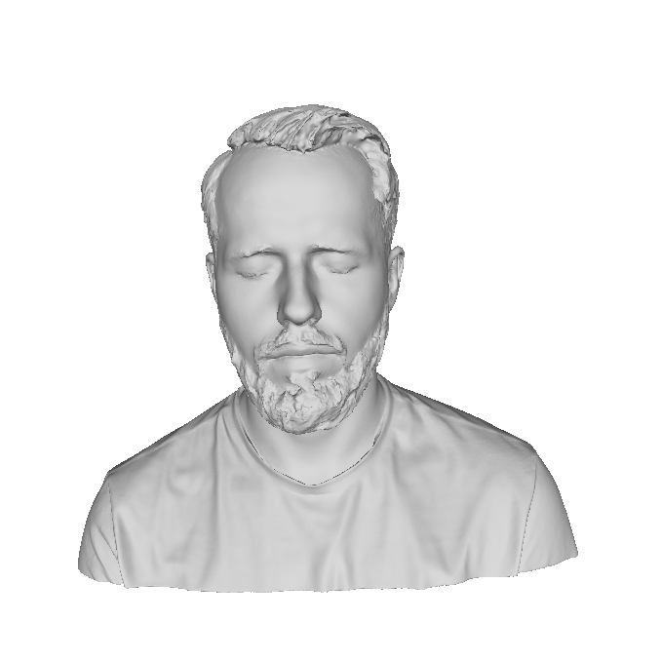
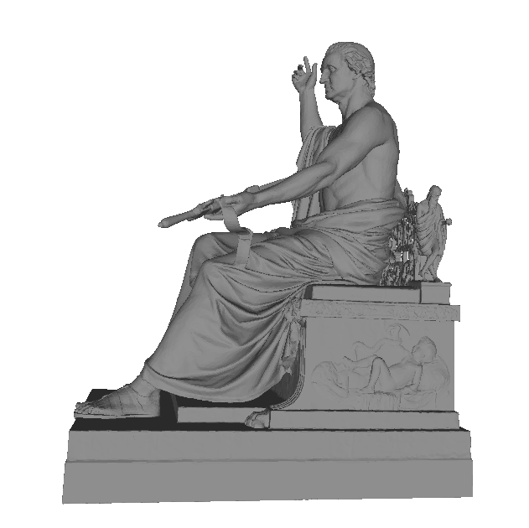
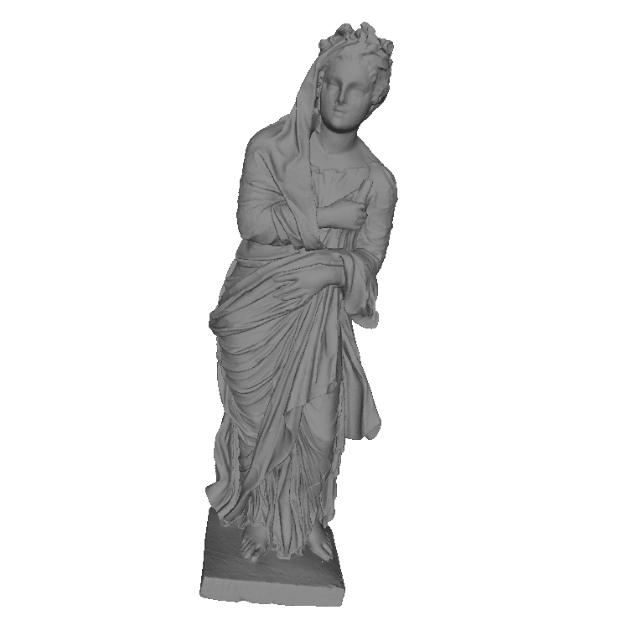
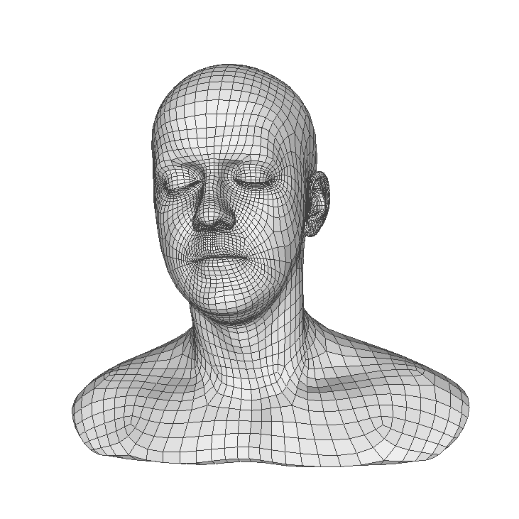
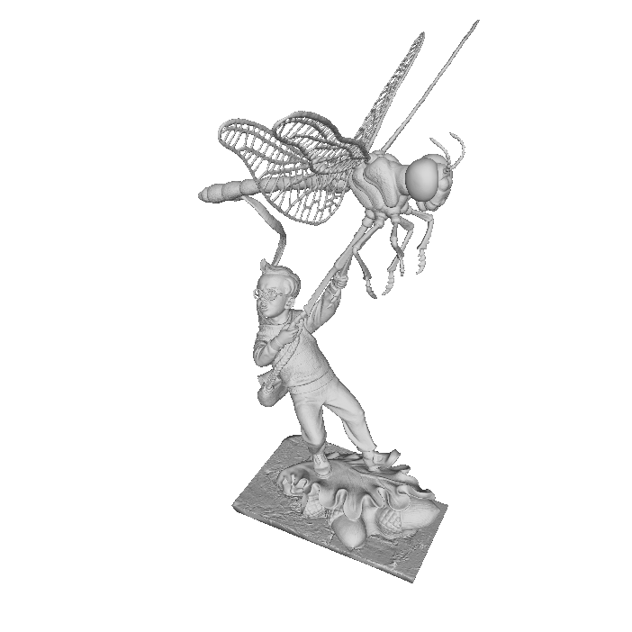
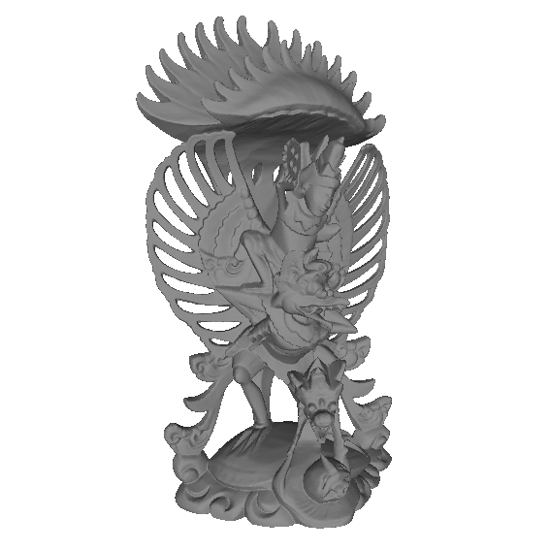
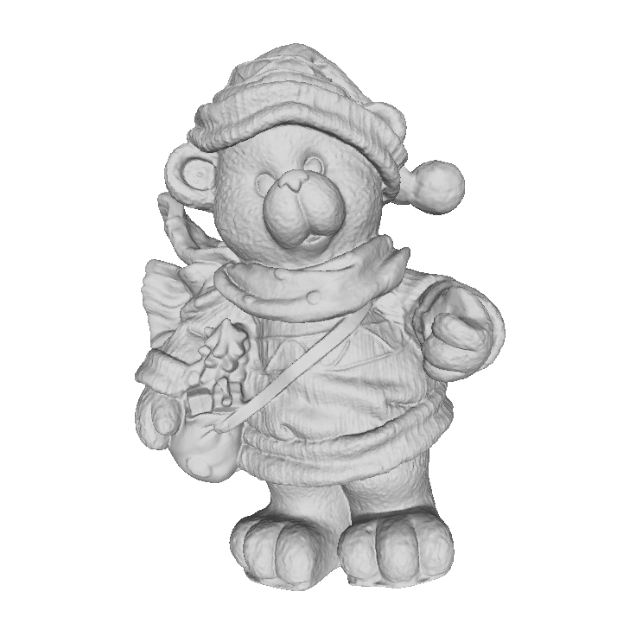
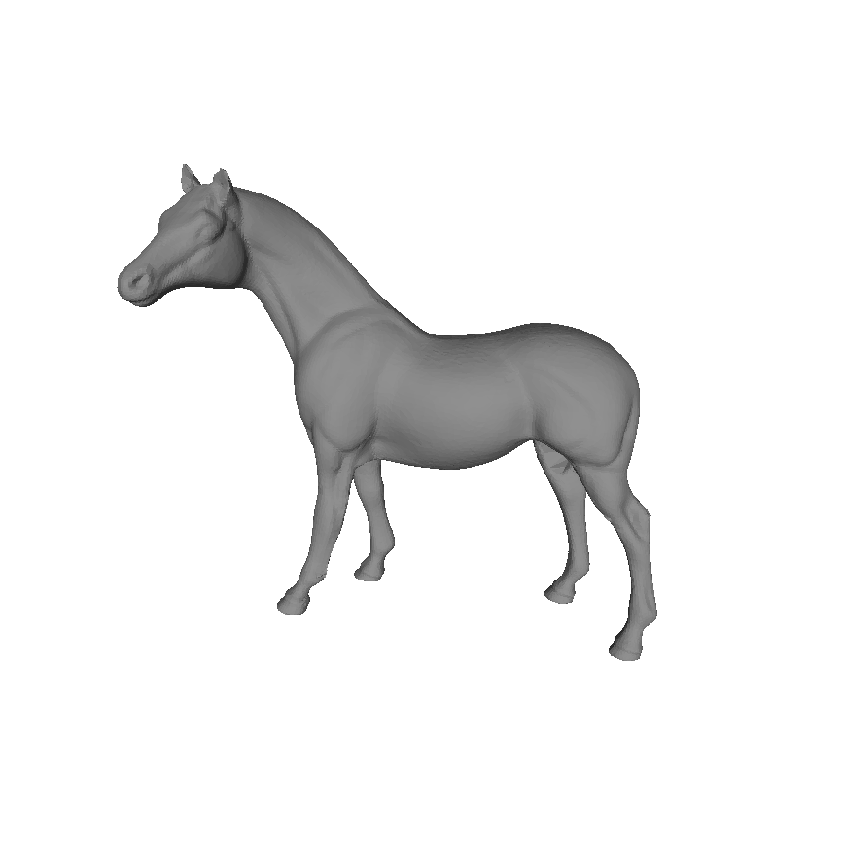
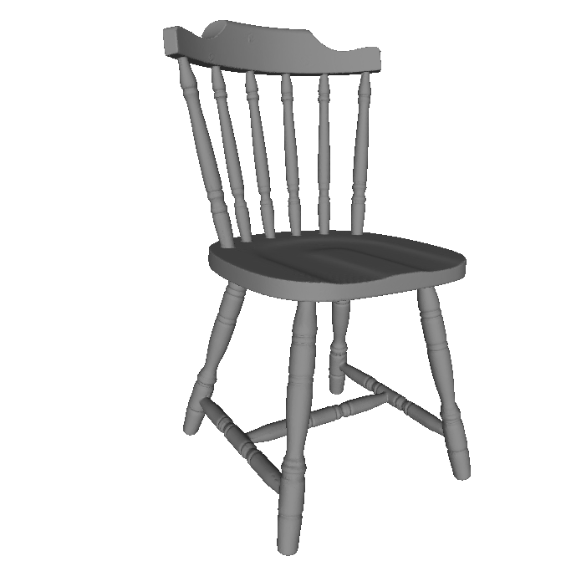
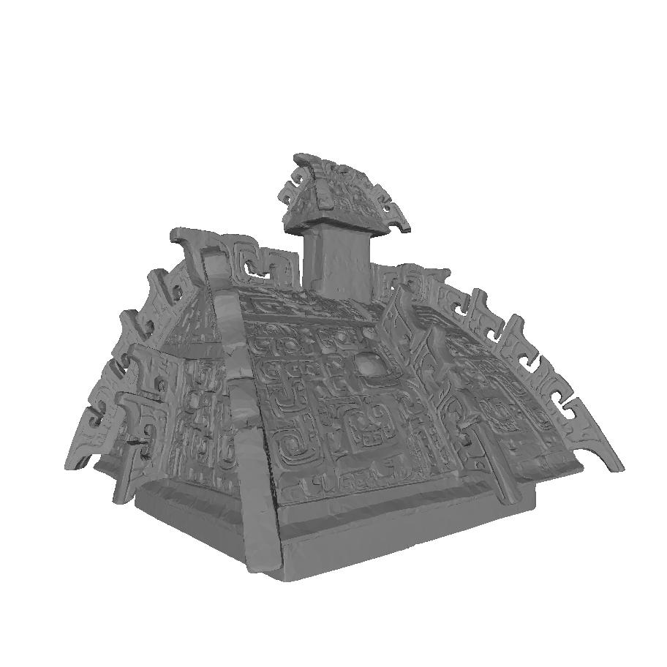
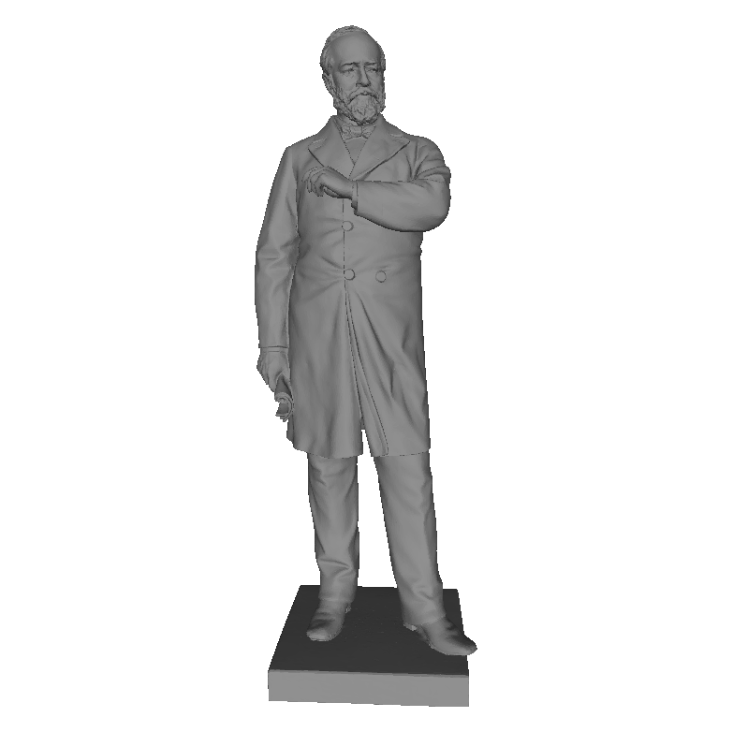
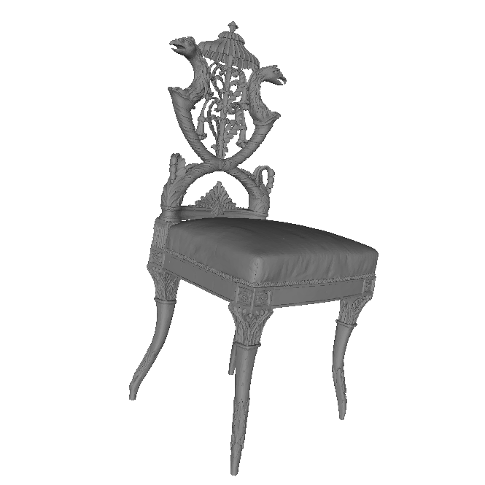
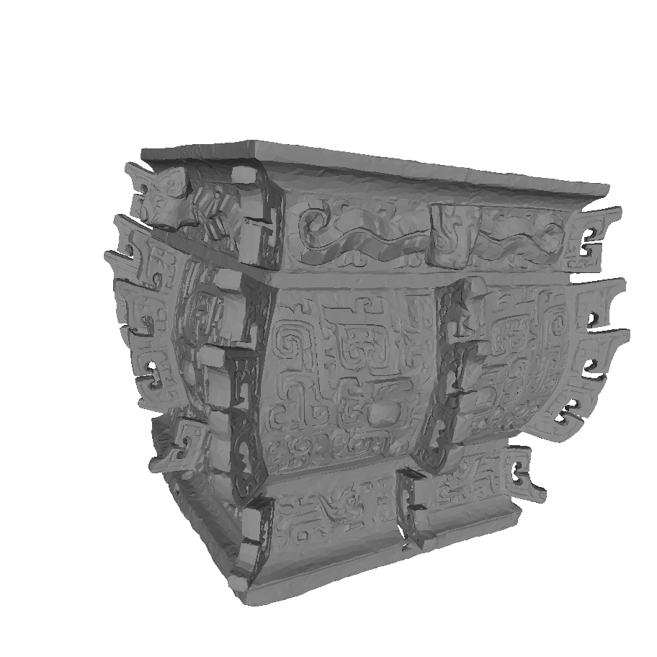
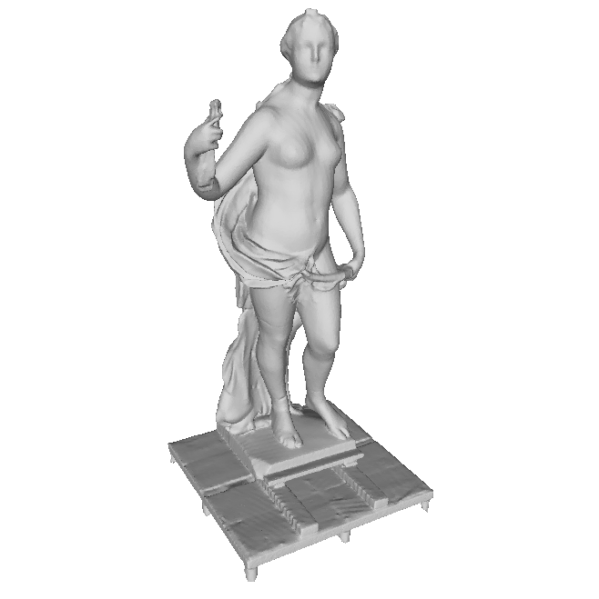
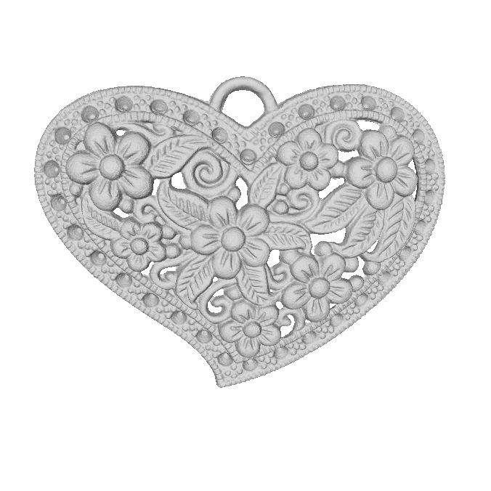
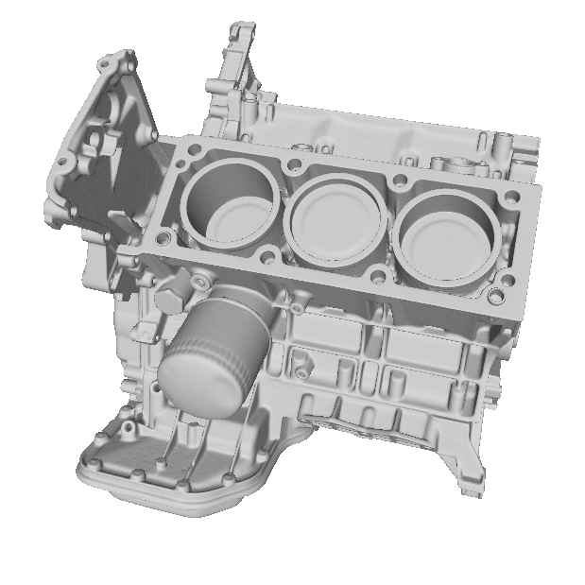
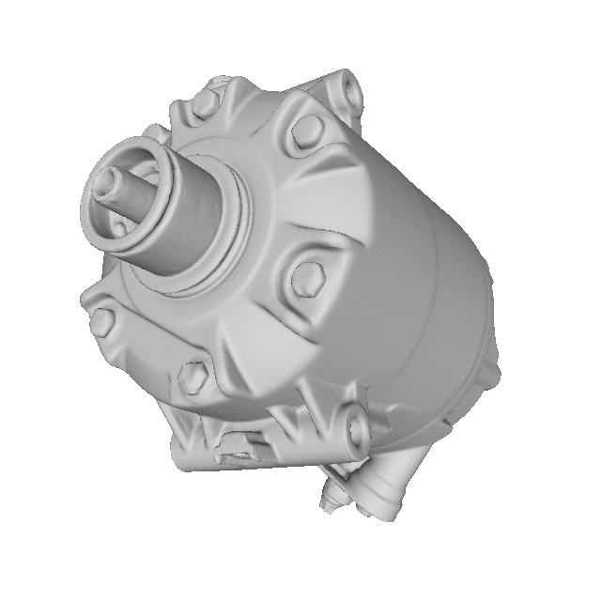
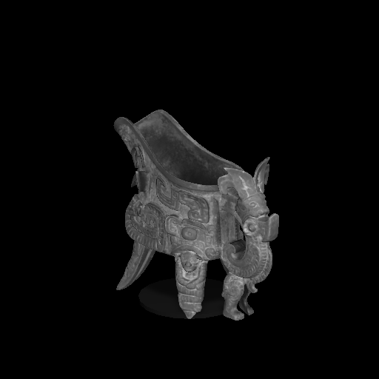
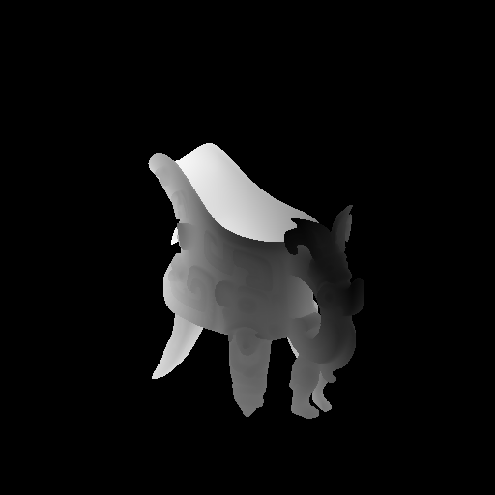
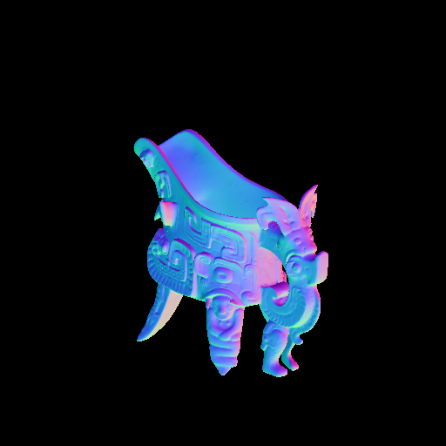








Improved Surface Normal Inference from Calibrated Illuminated RGB-D images
Jingyuan Sha
Notes:
Hello everyone, welcome to my thesis defense presentation. The title of my thesis is ….
So first let me introduce the task that we are going to solve,

Slide 2




Task: Surface Normal Inference
Gray-scale or RGB image
Normal Map (semi-dense)
Surface normals of a scene is presented as a normal map
Surface normal is shown in RGB color
We want to find the surface normal map of the corresponding scene.
Notes:
The surface normal is an important feature in 3D computer vision. Given the surface normal, we can use it for surface reconstruction, shading generation and other visual effects

Slide 3


Task: Surface Normal Inference
Standard method compute normal from point cloud using neighboring information or use Shape from Shading
Gray-scale or RGB image
Depth Map (semi-dense) , and known calibration
→point cloud or vertex map
Normal Map (semi-dense)
Normal Map are only semi-dense, if mapped on mesh (dense), that is not good at all
Dependent on chose neighbor size. If it is too small, → noise sensitive, If too large → too smooth and not crispy
Errors may occur in regions with interreflections, where we have errors in the 3D measurement
Notes:
Traditionally, we can use depth map as input to convert it to point cloud, and use neighbor based approach to estimate the surface normal.
However, the depth map in practice is only semi-dense, thus the corresponding normal map is semi-dense as well.
Besides, the neighbor based approach depends on a chosen neighbor size, if it is too small, too sensitive to the noise, too large, we loose the sharp details.

Slide 4



Motivation: Illuminated Calibrated RGB-D Image + Deep Learning
Depth map (semi-dense)
Illuminated gray-scale image
Light map (semi-dense)
Depth Map (semi-dense)
Normal Map (fully-dense)
Illuminate the object by a strong directional light of the video projector, whose position is known.
There exists the theoretical relations between light position, normal direction, basecolor albedo…
Normals, basecolor, light can be assumed to change coherently, which should be modelled within the neural network.
Notes:
Inspired by the photometric stereo, we use one extra strong directional light to illuminate the object surface, whose position is known, there exists theoretical relations between the light, normal and the basecolor albedo. We consider to use both geometry information provided depth map, and also the photometric information provided by the illuminated RGB images.

Slide 5



Overview of Ours
Vertex map (semi-dense)
GCNN
Normal Map
Notes:
We first designed a network just using geometry information, which takes vertex map as input.
The vertex map can be semi-dense, the network will inpaint the missing pixels and output fully dense normal map.
We call this structure as GCNN

Slide 6



Overview: Triple-Pipe-Network(Trip-Net)
Light map (semi-dense)
GCNN
Side-Pipe
Vertex map (semi-dense)
GCNN
Main-Pipe
Normal Map
Gray-scale Image (fully-dense)
GCNN
Side-Pipe
Notes:
Based on GCNN architecture, we duplicate it two times to take light map and gray-scale image as input. Thus the network will also extract the features from these two types of data, the light map is also semi-dense, since it is converted from vertex map. The output is the normal map as well. Note that there exist communication between different pipes.
Since the network looks like three parallel pipes, so we call it triple-pipe network, in short, Trip-Net.

Slide 7
Gated Convolution Neural Network (GCNN)
Designed For:
Input data might be semi-dense but output is fully-dense.
Output data has Same resolution as input data.
Output data retains the fine details in the input data.
Notes:
First let me introduce the proposed core-network in this thesis called gated convolution neural network.
It is designed to solve the tasks like input data is semi-dense, but we want the output data to be fully dense as much as possible
And for the task like normal inference, we want the output has the same resolution as input, thus we have a 1-1 mapping, so each normal corresponds a vertex.
And also, we want to retain the fine details in the input data.

Slide 8

U-Net: exists solution for upsampling task
U-Net Architecture
Fully-Convolution design
Up-sampling for high resolution output
Skip connection guarantee sharpness
Input data is fully dense, not suit for semi-dense input data.
Output resolution smaller than input
One type of input only
Notes:
U-Net is a very good designed architecture, which is initially used in image segmentation area. It has multiple upsampling operations to guarantee high resolution output. The skip connection connects the high resolution feature maps from downsampling part with upsampling features, which provides further sharpness in the output.
However, it was designed to deal with fully dense input data like images. In normal inference task, our data is only semi-dense, thus it requires special operations to deal with missing regions. Besides, the output in the original U-Net is smaller than the input resolution, so it cannot guarantee a 1-1 mapping.
The network also has only one type of input.

Slide 9




Gated Convolution Layer (gconv)
Gate: learn to find a mask from data
$Gating_{\left\{y,x\right\}}=ΣΣ W_{g}⋅I$
$Feature_{\left\{y,x\right\}}=ΣΣ{ W}_{f}⋅I$
$O_{\left\{y,x\right\}}=φ\left(Feature_{\left\{y,x\right\}}\right)⊙σ\left(Gating_{\left\{y,x\right\}}\right)$
$φ:leakyReLU$
$σ:Sigmoid$
Notes:
To solve the semi-dense input problem, we use gated convolution layer to replace the standard convolution layer. As shown in the Figure, the left is gated convolution whereas the right is standard convolution.
For the gated convolution, we make a dual-layer design with 2 layers, one of the convolution layer extract the feature map with leakyReLU activation fuction, this is exactly the same as standard convolution layer design. The difference is, we use another convolution layer as gating layer to estimate the confidence of each pixel, where it use sigmoid activation function. The output is the element-wise product of gating and features.
The gated convolution layer learns the confidence during the training and consequently the feature maps have less impact with the input noise.

Slide 10

Proposed Network: GCNN
Down-sampling
Up-sampling
Architecture:
3 gated conv Layers
3 times downsampling (gated conv layers)
3 times upsampling (gated conv layers)
2 conv2d layers (standard conv layers)
Properties:
Designed for geometry based approach
Input: Vertex Map
Output: Normal Map
Notes:
Based on U-Net and gated convolution, we designed following architecture.
We mainly use gated convolution in our network , as shown in cyan color
In each gated convolution, we padded the border to keep the resolution as same as last layer
We use convolution with stride 2 to down-sampling the feature maps.
We repeat it 3 times.
In the up-sampling part, the feature map is interpolated first to double the feature map size, then use skip connection to concatenate the high resolution feature in the down-sampling part, then another gated convolution layer is followed afterward to reduce the channel size. The upsampling repeats 3 times, the output has the same resolution as input.
Finally, we use two standard convolution layer to predict the normal map.

Slide 11

Consider illuminated information
Network requirement:
- Take 3 kinds of input data, whereas each kind of data has different channels
Able to deal with semi-dense input
Output is normal map with 3 channels

Slide 12

Trip-Net
Side-Pipe
Main-Pipe
Side-Pipe
Notes:
Based on GCNN architecture, we designed our proposed network Trip-Net, which takes image, vertex map and light map altogether as input for surface normal inference task.
This network has three pipes, each pipe has its own input. The output is the corresponding normal map.
In the upsampling part, we use 4 fusions to integrate the feature map from the side pipes to the main pipe. Thus, during the upsampling, the network will consider the feature maps not only on the vertex map, but also the illuminated information from image and the light map.

Slide 13
Dataset
Training
50 point clouds
5 point clouds
Test
Notes:
In order to train our network, we created a dataset based on 55 3D objects. We searched them from Internet and use 50 for training and 5 for test.

Slide 14





Image
Depth Map
Normal Map
Camera Preview
Object
Light
Unity Scene
Depth Camera
Notes:
We generate the synthetic scenes using 3D game engine Unity to simulate the light scanner in the labortary. First we place a calibrated depth camera, whose intrinsic and extrinsic matrix is known. Then we placed a strong direction light nearby, whose position is also known. The object is placed on a small stage, where the light can properly illuminate the surface and the camera can capture the corresponding scene.
We take a gray-scale image, depth map as well as the normal map for each scene. All the data are fully-dense. So we have the geometry information as well as illuminated information.

Slide 15

Adding Noise
Notes:
In order to simulate the noise in the light scanner, we applied a random drop-off noise to our depth map. The noise intensity is controlled by a parameter mu, which denotes the percentage of drop-off, the range of mu is randomly chosen from 0 to 50 for each scene.

Slide 16










Recorded Data
Image
Normal
Depth
Noised Depth
For the same object, we capture the scenes from a number of random directions
Random Light position
Random object position and orientation
Notes:
For the same 3D object we capture the data from different directions by random changing the light position and the object position, as well as the orientation. Each row in the figure is one training case.

Slide 17



Dataset
Synthetic Dataset
Real Dataset
Simulated from Unity
Image resolution: 128x128/ 512x512
50 training objects
5 test objects
3000 training scenes/5000 training scenes
100 test scenes
Captured on a light scanner
Image resolution: 512x512
4 training objects
1 test objects
320 training scenes
80 test scenes
Notes:
We prepared two types of data in total. The synthetic dataset we prepared in two kinds of resolutions with 128 and 512 respectively. We generate 3000 scenes in the small resolution and 5000 scenes in large resolution. Each resolution prepared 100 test scenes.
For the real dataset, we only have 4 training objects and 1 test objects with 320 training scenes and the 80 test scenes. It has only resolution 512.
We trained our models on different dataset and observe the performance.

Slide 18
Notes:
Quantitative evaluation

Slide 19



Evaluation Metrics
Average angle error
Median angle error
Degree Percentage Evaluation
5
11.5
22.5
30
Notes:
We use multiple metrics for quantitative evaluation.

Slide 20






Applying scenarios for surface normal
Image
CNN
NOC
GCNN
Trip-Net
GT
Notes:
The surface normal estimation has been extensively researched in recent years. Given the surface normal, we can use it for surface reconstruction, shading generation and other visual effects

Slide 21




Object: Dragon
Resolution: 128x128
GT
GCNN
CNN
NOC
GCNN gives a much accurate result compared to CNN
Skip connection
0
90

Slide 22




SVD visual evaluation
Fully dense Input
GT
SVD
Error
K=1
0
90
Notes:
Fully dense input, good result, the window size is already the smallest, but the detail is still missing.

Slide 23



SVD visual evaluation
Semi-dense Input
GT
SVD
K=2
Error
0
90
Notes:
For the semi-dense input, the result goes worse, even the smooth area(skin) is not accurate.

Slide 24

128 CNN Feature Maps
Size: 32x32
value: 0
1

Slide 25

128 NOC Feature Maps
Size: 32x32
value: 0
1

Slide 26

128 GCNN Feature Maps
Size: 32x32
value: 0
1

Slide 27

Recall: Surface Normal at point P
Surface Normal
Tangent plane
Properties:
Unit Vector in 3D space
Perpendiculer to the tangent plane at point p
Direction point outward of the object surface
Surface Point P
Surface
Image Source: https://upload.wikimedia.org/wikipedia/commons/7/7e/Surface_normal_illustration.png

Slide 28

Improved Normal Inference from Calibrated illuminated RGB-D images
Photometric Stereo
…
Image 01
Image 02
Image …
Normal Map
Assume Lambert surface
Requires multiple lights for good estimatioin
Solved using least squares method
$$I={(L}_{0}ρ⊙N)⋅(L)$$

Slide 29



Surface Normal Estimation
Surface normals of a scene is presented as a normal map
One Surface normal is mapped to a RGB color
We want to find the surface normal map of the corresponding scene.
Grayscale Image
Point cloud
Normal Map
Viewing of 3D object from a direction
The points are in 3D space
Each point corresponds a pixel in the gray-scale image
Map normal in 3D space to RGB color

Slide 30

Surface Normal Estimation
(Geometry-based Approach)
Surface Normal
Tangent plane
Point Cloud
Normal Map
Surface
Drawbacks:
Normal Map are only semi-dense
Depends on chosen neighbor size,
if it is too small → noise sensitive,
If too large → too smooth and not crispy
Assume neighbors of each point are on the same plane, then construct the tangent plane based on these points
The normal of the tangent plane is the approximation of corresponding surface normal
Image Source: https://upload.wikimedia.org/wikipedia/commons/7/7e/Surface_normal_illustration.png
Notes:
For each point, we assume its neighbors within some distance are on the same plane, then we can uses these points to consctruct a plane. The normal of the plane is approximately the surface normal at this point.
We do this point-wisely to get the final normal map.
Drawbacks:
Normal map is only Semi-dense if mapped on mesh (dense), that is not good at all

Slide 31




Geometry-based Approach
Input
Output
Neighbor information
K,R,t
3D Object
Depth Map
Point cloud
Normal Map
Optimization based
Normal Map are only semi-dense, if mapped on mesh (dense), that is not good at all
Depends on chosen neighbor size, if it is too small → noise sensitive, If too large → too smooth and not crispy

Slide 32

Traditional Approches
1
Geometry based Approach
Depth Map
Point cloud
Normal Map
2
Photometric Stereo
3D Object
…
Image 01
Image 02
Image …
Normal Map

Slide 33


Point Cloud
Grayscale image

Slide 34




Gated Normal Neural Network (GNNN)
Gated Convolution
Learn to find a mask from data
$Gating_{\left\{y,x\right\}}=ΣΣ W_{g}⋅I$
$Feature_{\left\{y,x\right\}}=ΣΣ{ W}_{g}⋅I$
$O_{\left\{y,x\right\}}=φ\left(Feature_{\left\{y,x\right\}}\right) ∗σ\left(Gating_{\left\{y,x\right\}}\right)$
$φ:leakyReLU$, $σ:Sigmoid$
Add Lambertian Reflection constrain to calculate albedo
$ρ=\frac{I}{N∗L}$
$I$are known beforehand, predict $N$ and $L$
$minimize || (\hat{N}∗\hat{L}) −\left(N∗L\right)|{\left.​\right|}_{2}$
Down-sampling
Up-sampling
Notes:
Skip connections: Propagate detailed color or texture information to the decoder of that region

